Slide 1




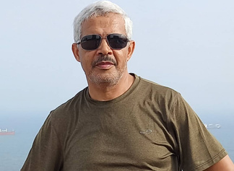
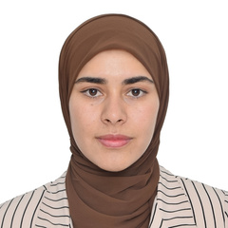
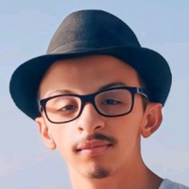
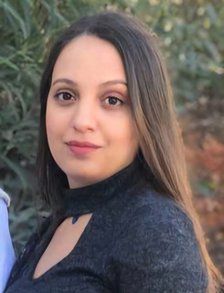
AAF Summer University 2025
SAFE
Interdisciplinary StartUp Initiative Challenge
Safe Water Safe Money
Benaissa
Mehenni Nor-Elhouda
University professor at the University of Tiaret
PhD Student in Telecommunications Systems
Department of Electronics, Farhat Abbas University Sétif 1, Algeria
BENOUALI ABDELKADER
Meryem Yassamine KHELIL
MASTER 1 Student AI & cyber security University Ain Temouchent
PhD Student in Plant Protection
Departement of agronomy Mohemd Khider biskra, Algeria
ISI27
Notes:
1

Slide 2
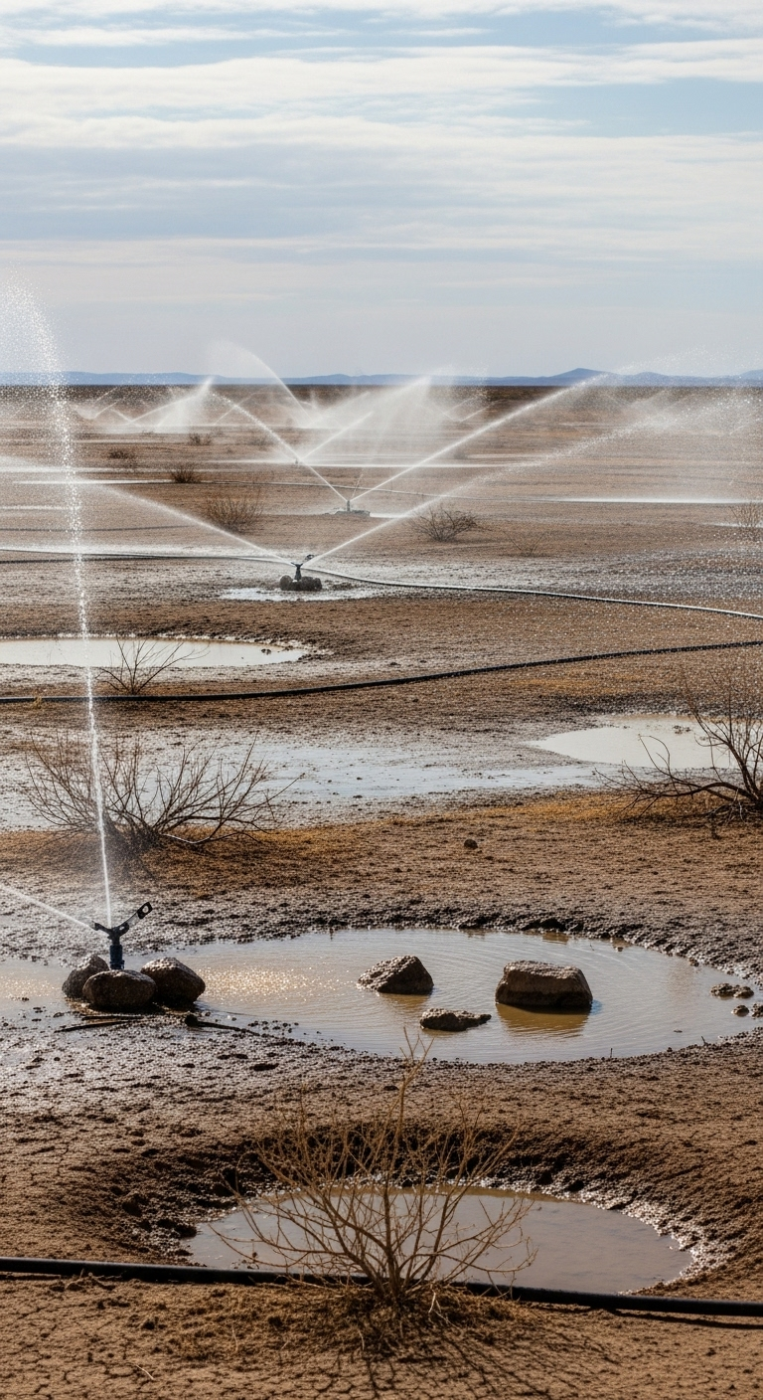
AAF Summer University 2025
Notes:
10

Slide 3
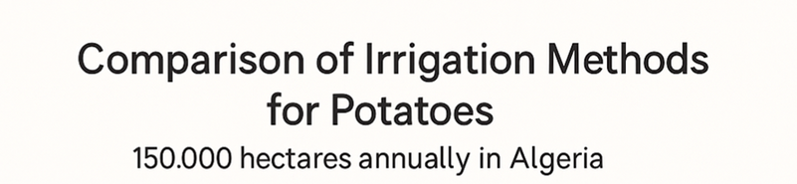

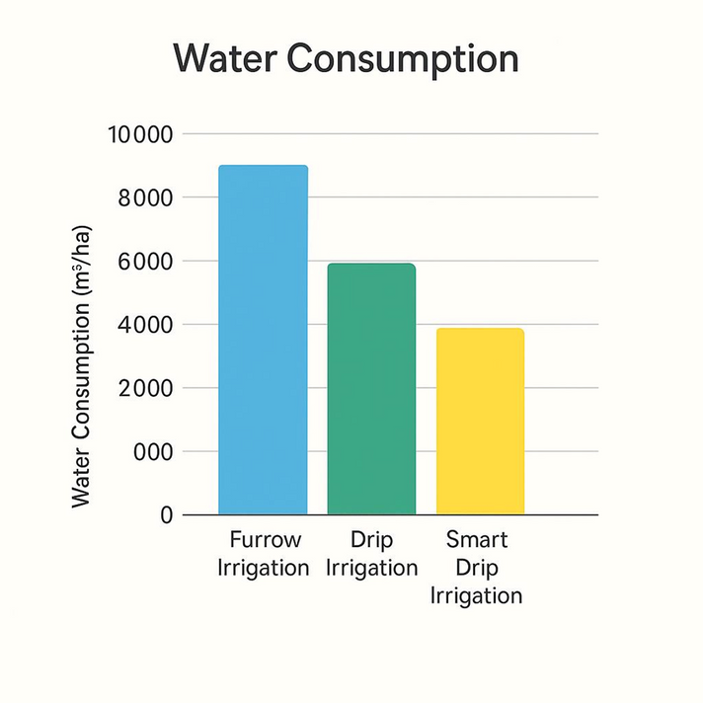

AAF Summer University 2025
IDENTIFIED CHALLENGE

Slide 4
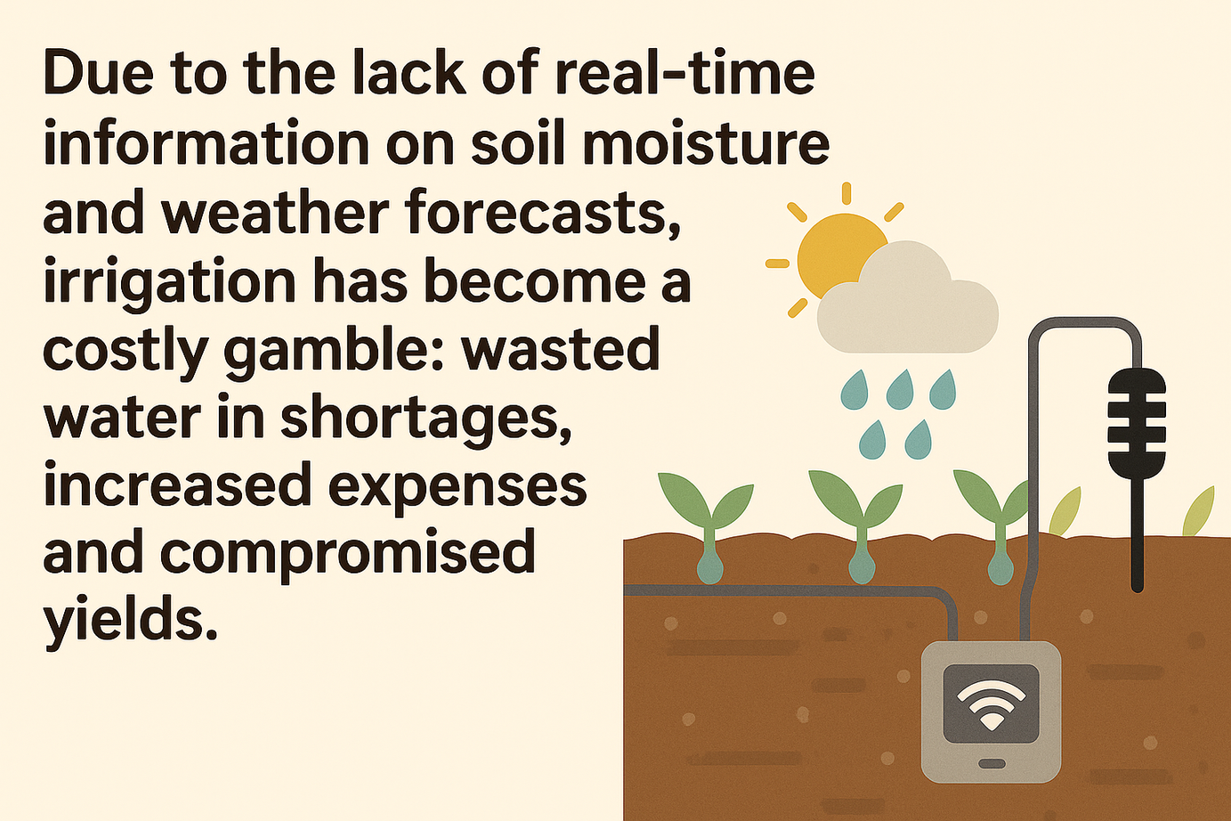
AAF Summer University 2025
IDEA

Slide 5
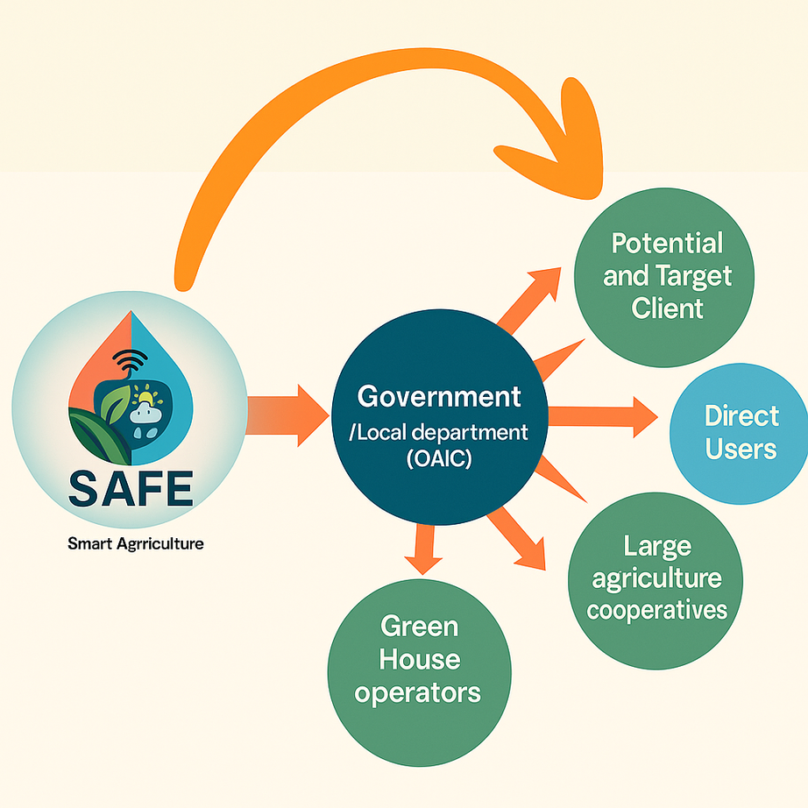
AAF Summer University 2025
Potential and Target Client
FARMER
6

Slide 6
AAF Summer University 2025
Sales
Source of income
Maintenance
Subscription
Rental
6

Slide 7
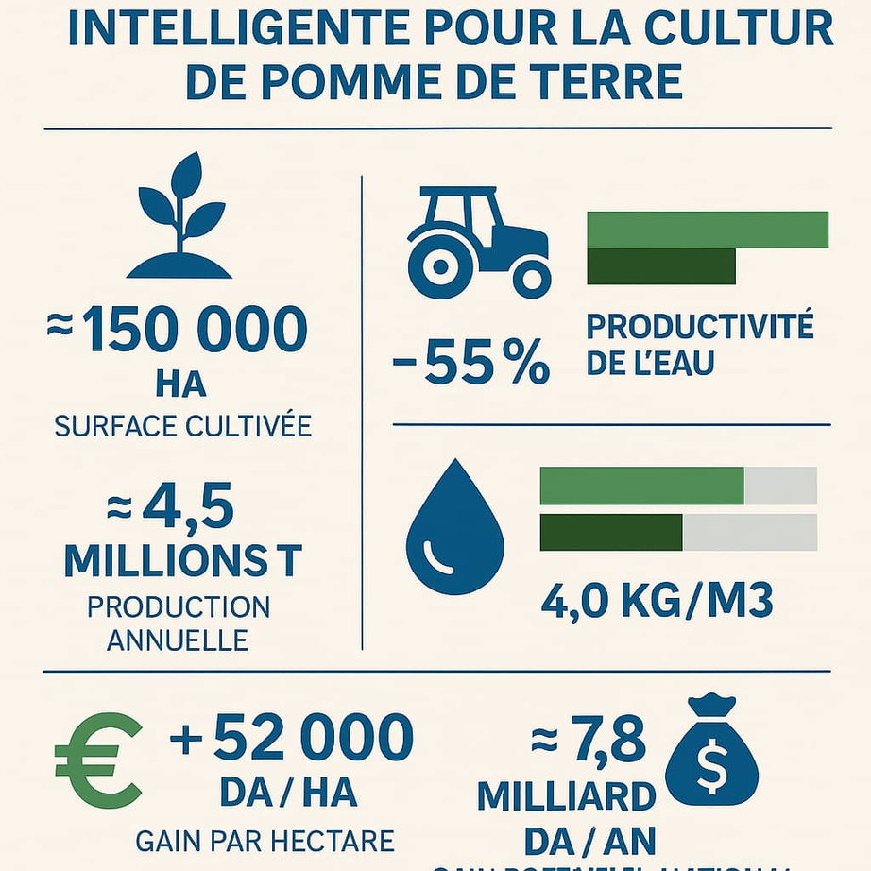
AAF Summer University 2025
Added value
Notes:
4

Slide 8


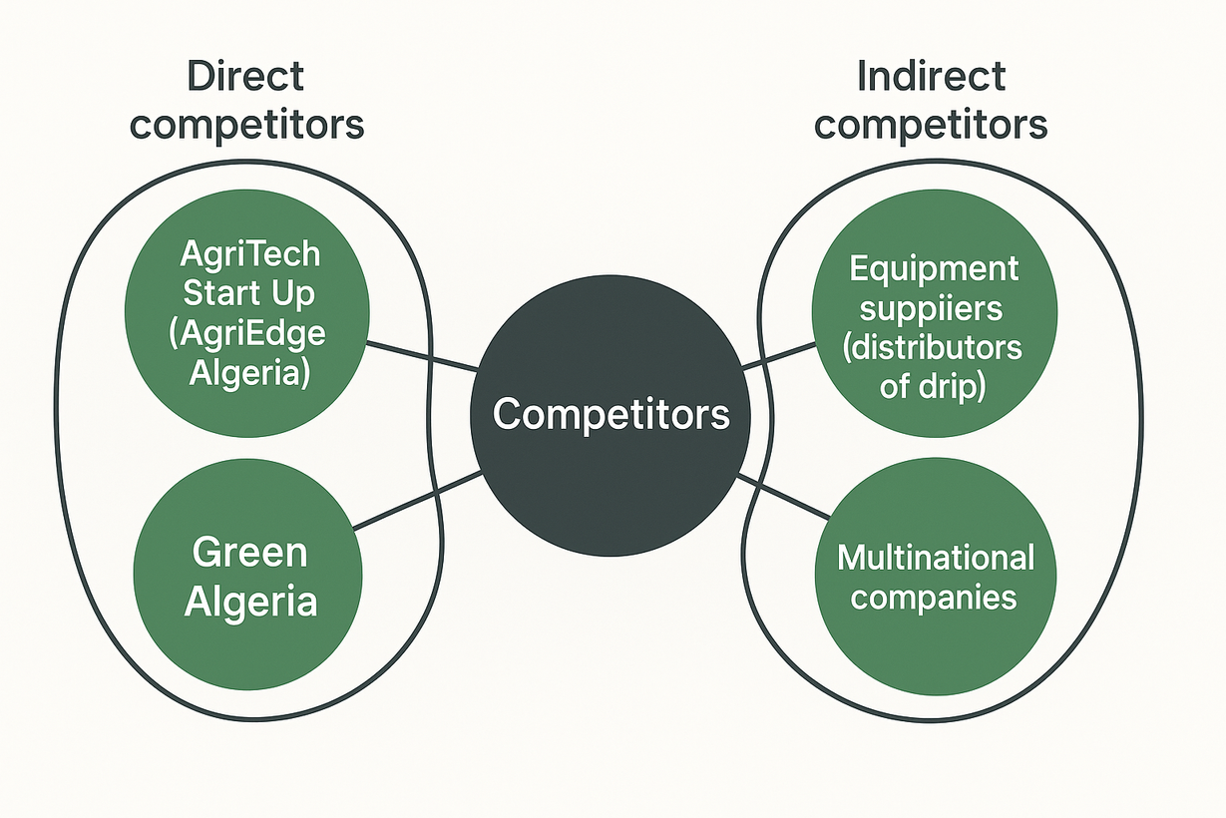





AAF Summer University 2025
MARKET
Competitors

Slide 9
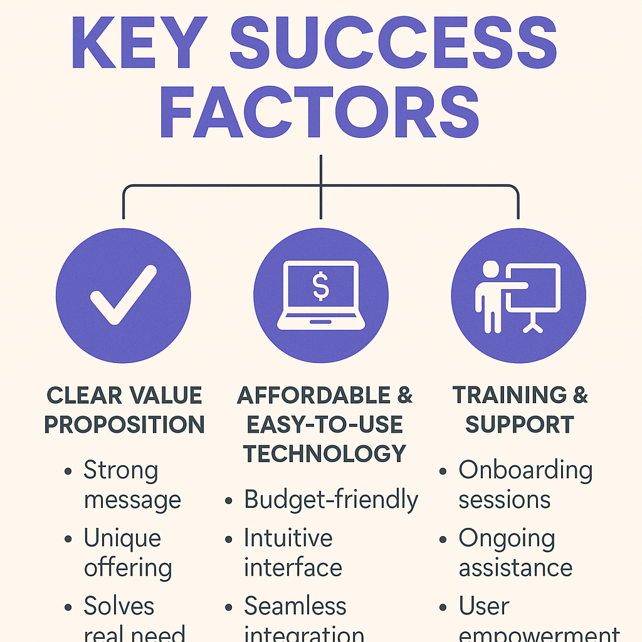
AAF Summer University 2025
Notes:
8

Slide 10
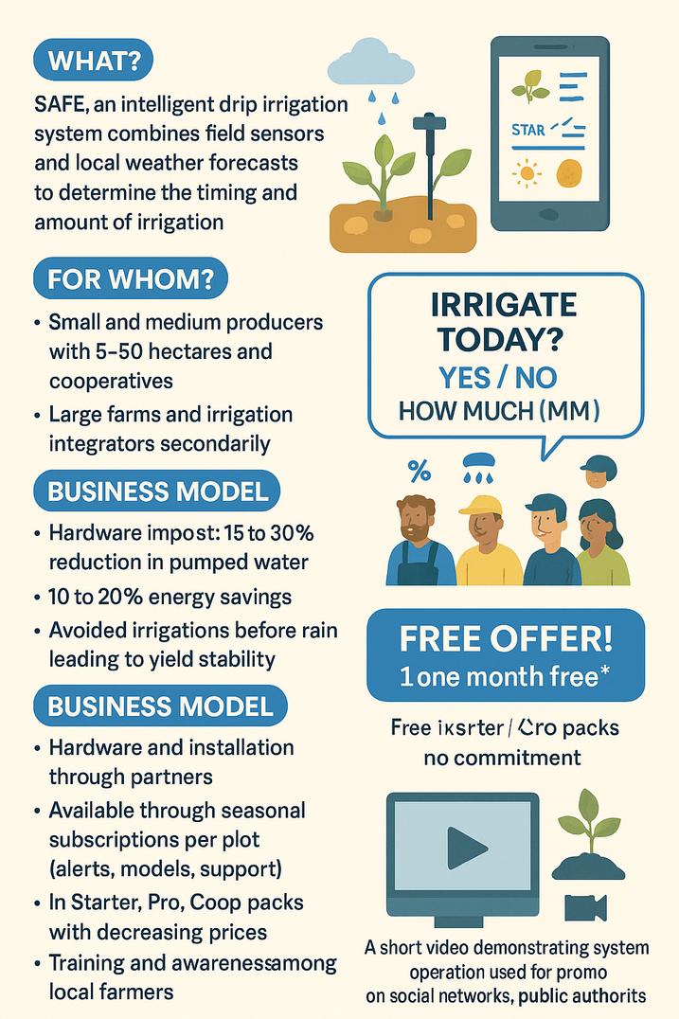
AAF Summer University 2025
Marketing strategy
Notes:
9

Slide 11
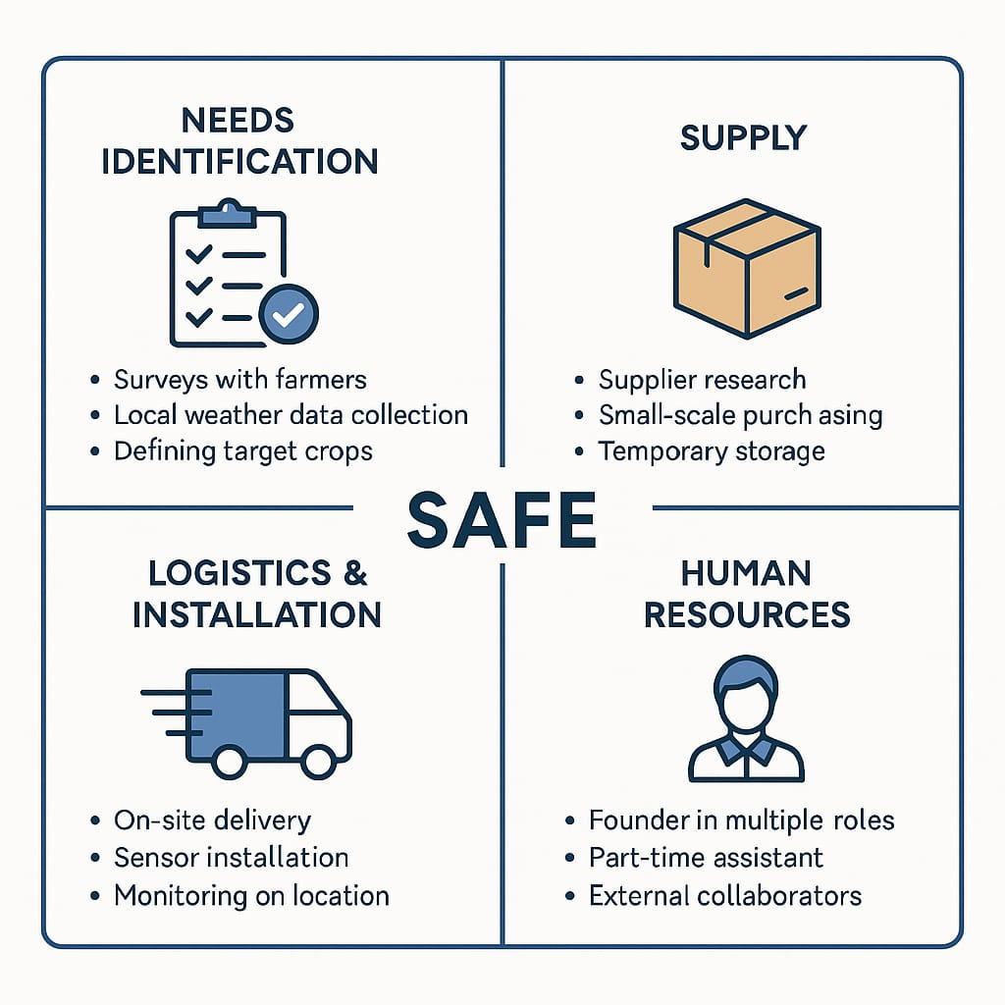
AAF Summer University 2025
Organization Structure
Notes:
10

Slide 12
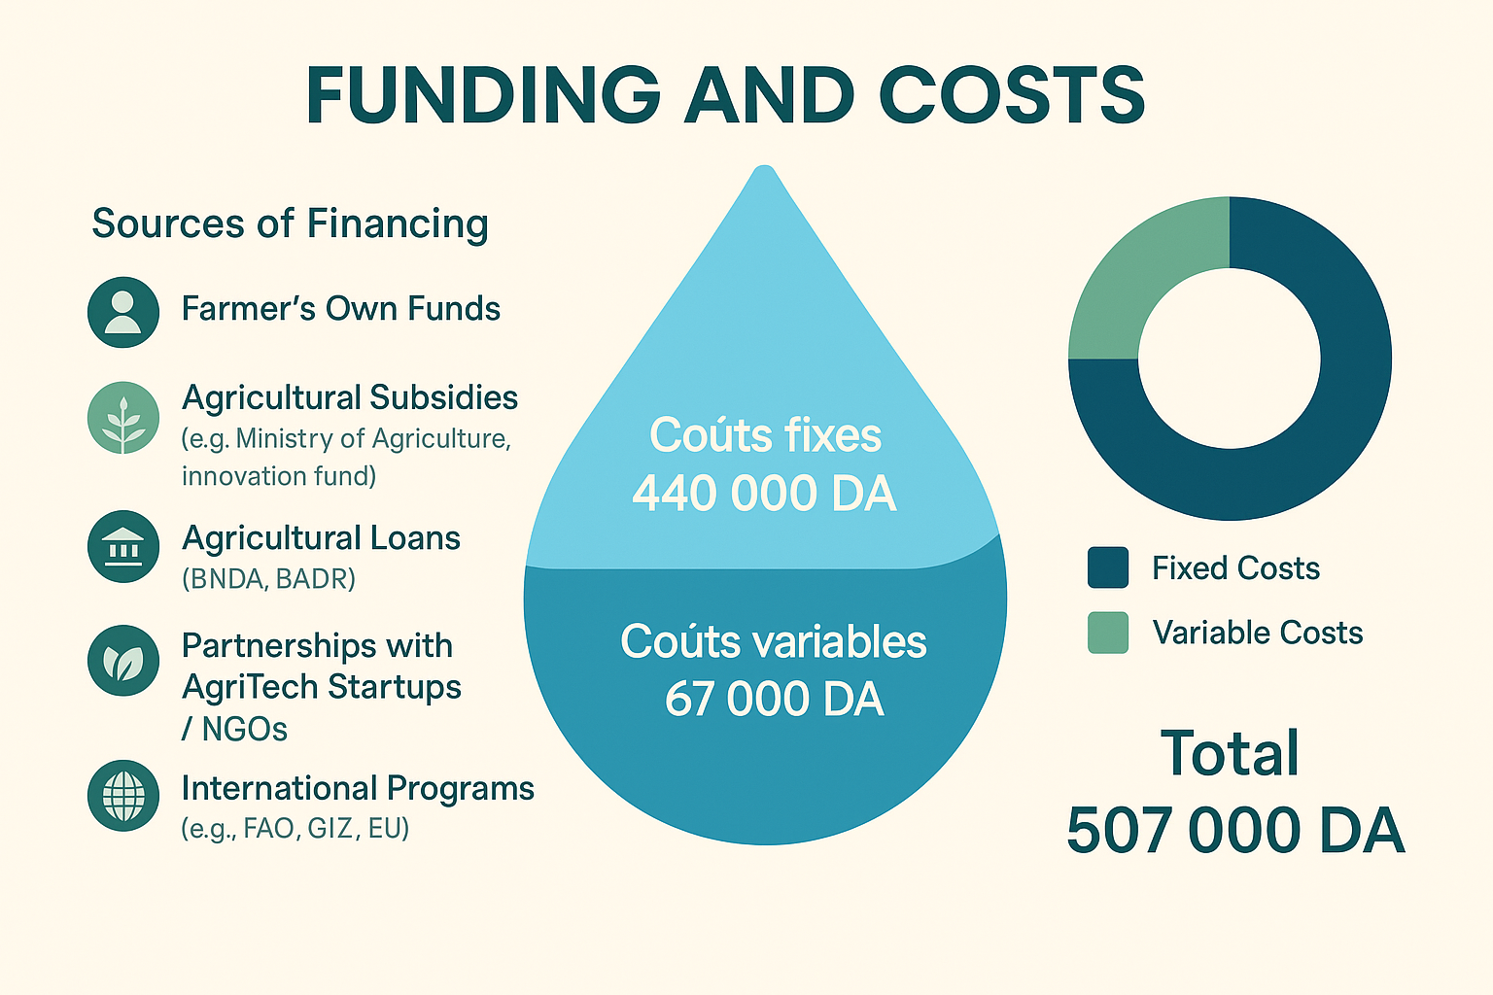
AAF Summer University 2025
Funding
Fixed Costs
Variable Costs
Notes:
4

